Slide 1
Uber fares Predictions
Regression Problem Chapter 2
Notes:
NOTE:
To change the image on this slide, select the picture and delete it. Then click the Pictures icon in the placeholder to insert your own image.

Slide 2
Methodology
Problem Understanding
Data Understanding
Data Preparation
Modeling
Evaluation
Deployment

Slide 3
Problem Statement
Uber is a taxi company that has thousands of daily customers and lacs of daily transaction. So company needs a needs a system that accurately handle its fare system. This project is focused on predicting prices of the ride so that these fares are affordable for customer, driver has his margin and tha company goes in profit.

Slide 4
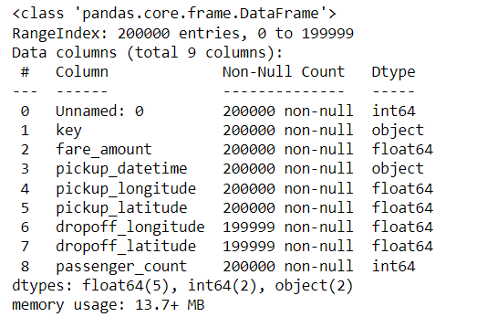
Data Understanding
We have following attributes:
Key
Fare amount
Pickup date time
Pickup Longitude
Pickup Latitude
Dropoff Longitude
Dropoff Latitude
Passenger Count

Slide 5
Data Description
Attribute Name | Description | Type | Range
key | A unique identifier for each trip | Object
Fare_amount | Fare of the ride | Float | (-52 to 499)
Pickup_datetime | Date and Time when the meter was engaged | Object
Pickup_Longitude | The Longitude where the meter was engaged | Float | (-1340.65 to 57.41)
Pickup_Latitude | The Latitude where the meter was engaged | Float
Dropoff_Latitude | The Latitude where the meter was disengaged | Float
Dropoff_Longitude | The Longitude where the meter was disengaged | Float
Passanger_Count | The number of passenger in the vehicle | Integer | 5.5 – 8 gm/dl

Slide 6
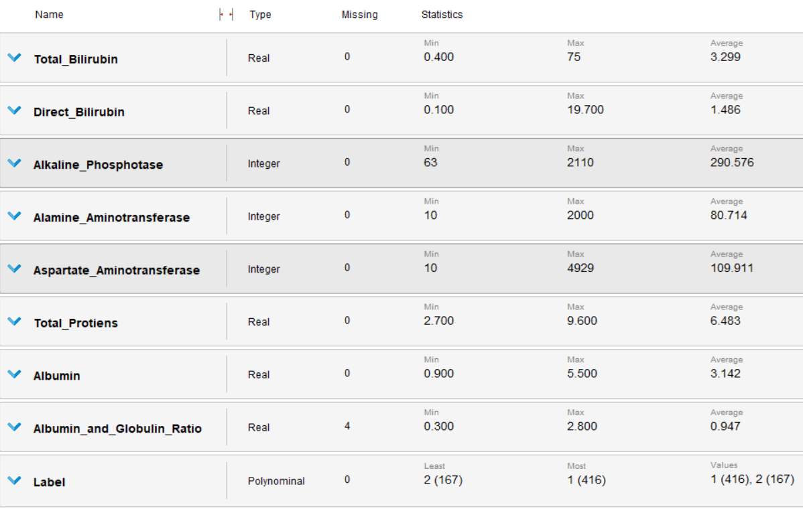
Data Statistics

Slide 7
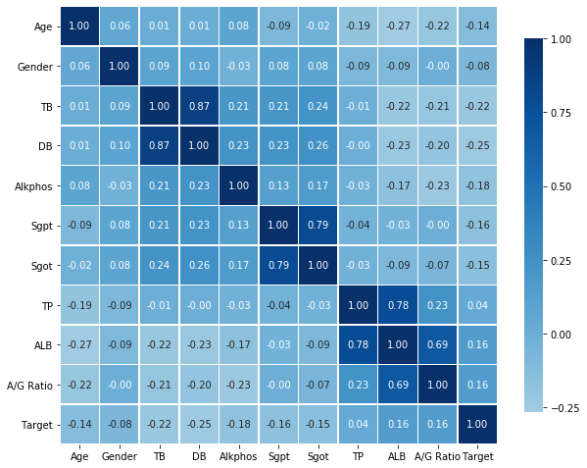
Data Correlation
Heap map for correlation of attributes

Slide 8
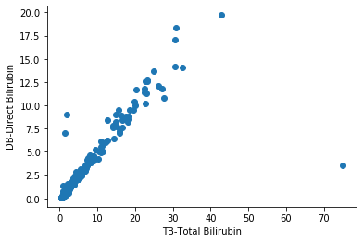
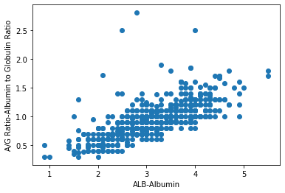
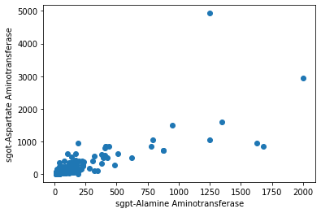
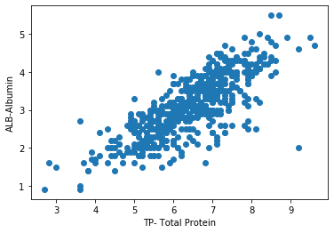
Data Correlation
Scatter plot of attributes with high correlation of attributes

Slide 9
Data Preparation
Missing Values
Outliers Detection and Removal
Data Balancing
Under Sample
Clustering
Over Sampling
Random
SMOTE
ADASYN
Features Selection
Correlation
PCA
Data Normalization

Slide 10
Modelling Without Preprocessing Techniques
Modelling Technique | Accuracy | AUC | Precision | Recall | F Measure | Sensitivity | Specificity
NB (Naive Bayes) | 57.8 | 0.75 | 0.9 | 44 | 59 | 44 | 94
GLM (Generalized Linear Model) | 74.1 | 0.79 | 0.8 | 90 | 83 | 90 | 28
LR (Linear Regression) | 73.5 | 0.78 | 0.8 | 89 | 82 | 89 | 28
FLM(Fast Large Margin) | 71.2 | 0.8 | 0.7 | 100 | 83 | 100 | 0
DT (Decision Trees) | 71.2 | 0.5 | 0.7 | 100 | 83 | 100 | 0
RF (Random Forest) | 71.2 | 0.8 | 0.7 | 100 | 83 | 100 | 0
GBT (Gradient Boosted Trees) | 72.9 | 0.79 | 0.8 | 89 | 82 | 89 | 31
SVM (Support Vector Machine_ | 74.7 | 0.64 | 0.8 | 93.2 | 83 | 93.2 | 28

Slide 11
References
E. Hashimoto, K. Tokushige, and J. Ludwig, “Diagnosis and classification of non-alcoholic fatty liver disease and non-alcoholic steatohepatitis: Current concepts and remaining challenges,” Hepatol. Res., vol. 45, no. 1, pp. 20–28, 2015.
B. Venkata Ramana, M. S. P. Babu, and N. . Venkateswarlu, “A Critical Study of Selected Classification Algorithms for Liver Disease Diagnosis,” Int. J. Database Manag. Syst., vol. 3, no. 2, pp. 101–114, 2011.
H. Jin, S. Kim, and J. Kim, “Decision factors on effective liver patient data prediction,” Int. J. Bio-Science Bio-Technology, vol. 6, no. 4, pp. 167–178, 2014.
R. Vahini and B. Sathees Kumar, “A survey on liver disorder using classification techniques in data mining,” Int. J. Appl. Eng. Res., vol. 10, no. 55, pp. 2796–2799, 2015.
A. Gulia, R. Vohra, and P. Rani, “Liver Patient Classification Using Intelligent Techniques,” vol. 5, no. 4, pp. 5110–5115, 2014.
M. Abdar, M. Zomorodi-Moghadam, R. Das, and I. H. Ting, “Performance analysis of classification algorithms on early detection of liver disease,” Expert Syst. Appl., vol. 67, pp. 239–251, Jan. 2017.
M. Wadhwa and S. Juneja, “Comparing Classification Models for Predicting,” vol. 7, no. 4, pp. 135–140, 2018.
K. Nagaraj and A. Sridhar, “NeuroSVM : A Graphical User Interface for Identification of Liver Patients PES Institute of Technology 2 . Literature Review,” 2015.
S. Bashir, U. Qamar, and F. H. Khan, “WebMAC: A web based clinical expert system,” Inf. Syst. Front., vol. 20, no. 5, pp. 1135–1151, 2018.
S. Perveen, M. Shahbaz, K. Keshavjee, and A. Guergachi, “A Systematic Machine Learning Based Approach for the Diagnosis of Non-Alcoholic Fatty Liver Disease Risk and Progression,” Sci. Rep., vol. 8, no. 1, pp. 1–12, 2018.

Slide 12
References
A. N. Arbain and B. Y. P. Balakrishnan, “A Comparison of Data Mining Algorithms for Liver Disease Prediction on Imbalanced Data,” Int. J. Data Sci. Adv. Anal., 2019.
M. Abdar, N. Y. Yen, and J. C. S. Hung, “Improving the Diagnosis of Liver Disease Using Multilayer Perceptron Neural Network and Boosted Decision Trees,” J. Med. Biol. Eng., vol. 38, no. 6, pp. 953–965, 2018.
N. Nahar and F. Ara, “Liver Disease Prediction by Using Different Decision Tree Techniques,” Int. J. Data Min. Knowl. Manag. Process, vol. 8, no. 2, pp. 01–09, 2018.
R. W. Hndoosh, S. Kumar, and M. S. Saroa, “Fuzzy mathematical models for the analysis of fuzzy systems with application to liver disorders,” IOSR J. Comput. Eng., vol. 16, no. 5, pp. 71–85, 2014.
H. Vaidya, “NEURO FUZZY BASED LIVER DISEASE,” no. 4, pp. 1400–1412, 2017.
S. Mishra, H. K. Tripathy, B. Mishra, and S. Sahoo, “Implementation of Classification Rule Mining to minimize Liver Disorder risks,” Int. J. Control Theory Appl., vol. 10, no. 18, pp. 17–124, 2017.
L. Anand and S. P. Syed Ibrahim, “HANN: A Hybrid Model for Liver Syndrome Classification by Feature Assortment Optimization,” J. Med. Syst., vol. 42, no. 11, 2018.
M. Kiran Kumar, M. Sreedevi, and Y. C. A. Padmanabha Reddy, “Survey on machine learning algorithms for liver disease diagnosis and prediction,” Int. J. Eng. Technol., vol. 7, no. 1.8, p. 99, 2018.
J. McDermott and R. S. Forsyth, “Diagnosing a disorder in a classification benchmark,” Pattern Recognit. Lett., vol. 73, pp. 41–43, 2016.
C. Pete et al., “Crisp-Dm 1.0,” Cris. Consort., p. 76, 2000.

Slide 13
Thank You

